Slide 1

A TALE OF TWO CITIES: Looking at Mumbai through the New York lens
A Project Report By:
Parth Sharma

Slide 2
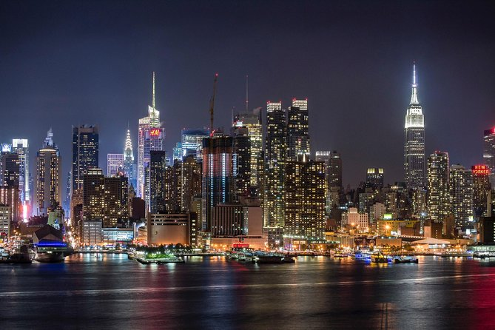
New York City
New York is considered one of the most influential cities on our planet. Being the financial capital of the United States of America, New York carries a certain weight. It is also the home to some of the wealthiest and most prominent people in our world. The success of New York can also be attributed to its urban planning, especially the Commissioner’s plan of 1811, that laid the roadmap to its success.
New York consists of five boroughs, namely Bronx, Brooklyn, Queens, Staten Island, and Manhattan. Among the five boroughs, Manhattan is considered the epicenter of the city’s growth.

Slide 3
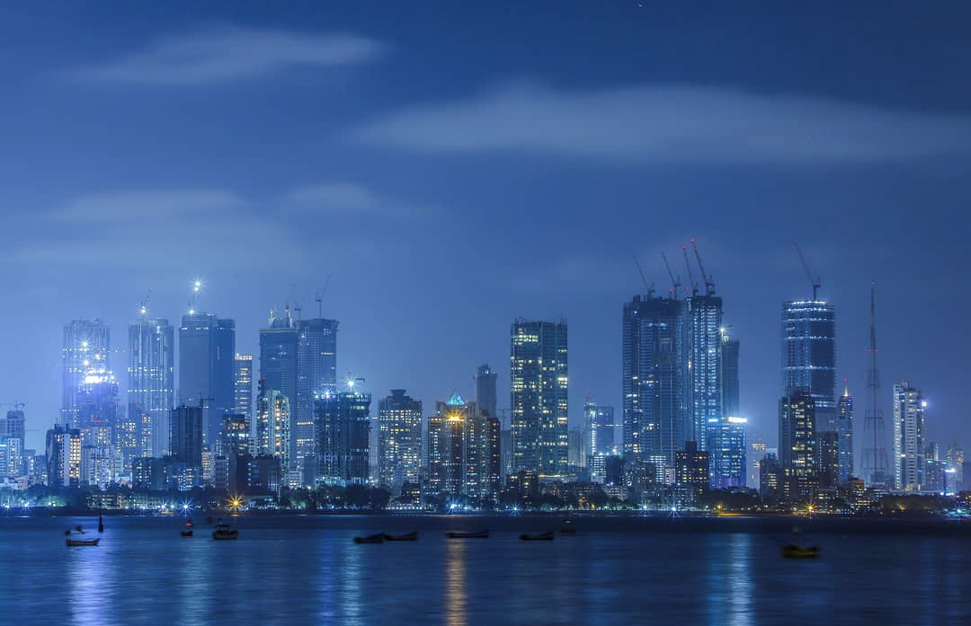
Mumbai City
Mumbai city is considered the financial capital of India and is the most influential city in the country. It is also the home to the wealthiest and most influential people of India. New York and Mumbai have many similarities and yet are different in so many aspects.
Despite being the richest city of India, Mumbai’s development was not planned, and that has restricted its growth despite its vast potential. It has become significantly overcrowded and expensive.

Slide 4
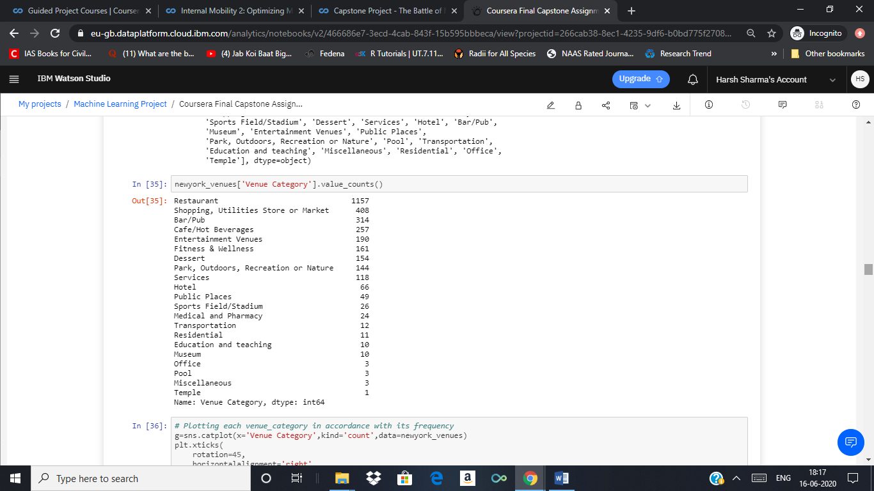
Data and Methodology
The first part of the project deals with accessing New York City’s neighborhoods’ data and segmenting them in clusters. For ease of handling data, only neighborhoods falling in the Manhattan borough was considered. Geopy package of python was used to get the coordinates for each neighborhood. The Foursquare location data was used to get the list of venues, venue category, and coordinates for each neighborhood. The list venues were categorized in over 330 categories in the original data. Although for the ease of handling, the venues were re-categorized in 21 broad categories

Slide 5
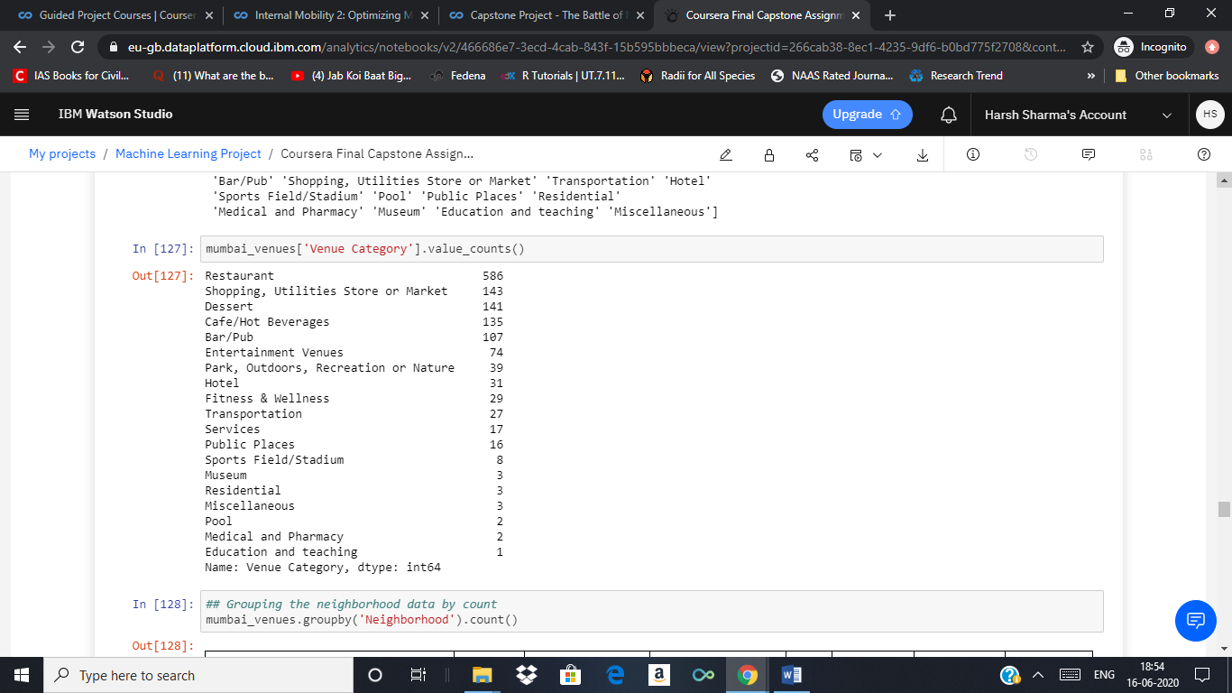
The dataset was then processed to get frequency of appearance for all venue category in each neighborhood. A final dataset comprising of each neighborhood and its top ten most common venue categories were compiled by defining a function to extract such a dataset.
Similarly, the Mumbai City data was exported from its Wikipedia page and processed to generate a similar dataset.
The k means clustering algorithm was used to segment this dataset in five clusters. These clusters were then explored by data visualization to understand the segmentation. Further, k nearest neighbors algorithm was used to train a model on the final New York data set, taking the top ten most common venue category columns as independent variables and the assigned cluster labels as the target variable. This model was then used to classify each Mumbai City neighborhood in five clusters

Slide 6
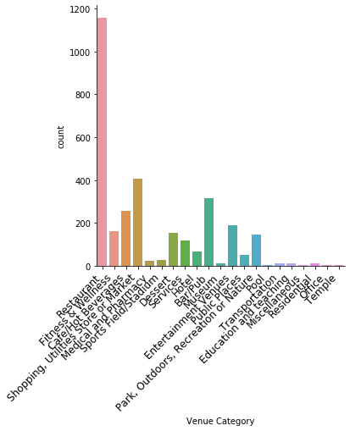
Results and Discussion New York City
A quick glance at the count of venue categories in both city’s datasets suggest an abundance of restaurants, dessert shops, cafes and shopping places in comparison to other venue categories. While it is natural to expect such venues to be in large number is all neighborhoods, this data is also due to lesser listings of venues such offices, teaching institutions, or religious places on the location provider services in comparison to restaurants and cafes.
33% of all the venues in Manhattan area belong to the ‘Restaurant’ category. Moreover, around 75% of all the venues belong to only top 5 venue categories by count.
It can be inferred that the neighborhoods become more distinct when we look at the less common venues types. Thus, it is the less frequent but distinct type of venues that make a neighborhood unique.
Count of venue categories in New York city data

Slide 7
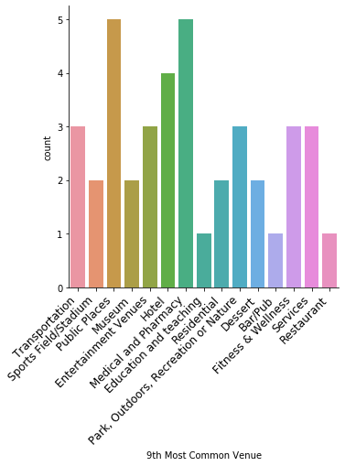
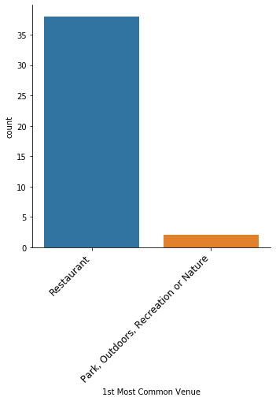
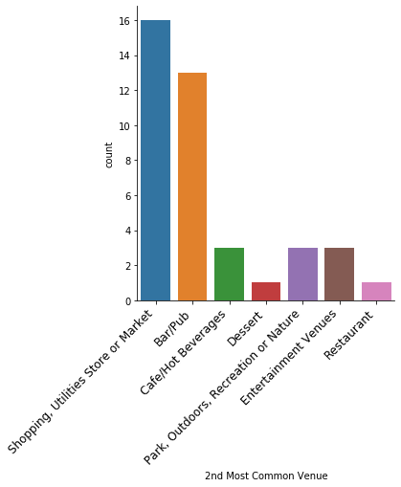
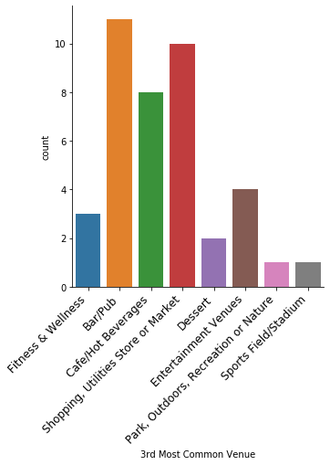
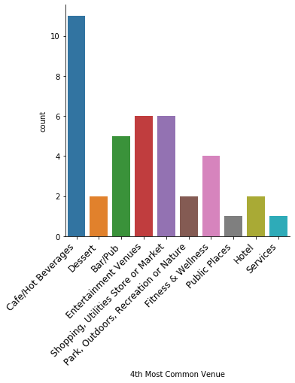
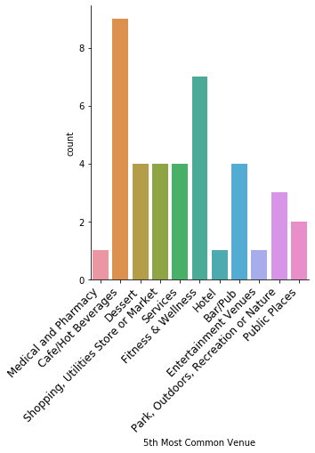
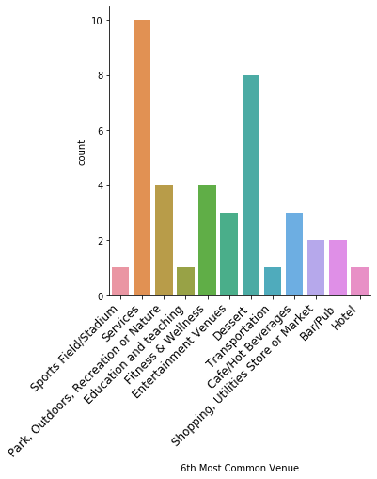
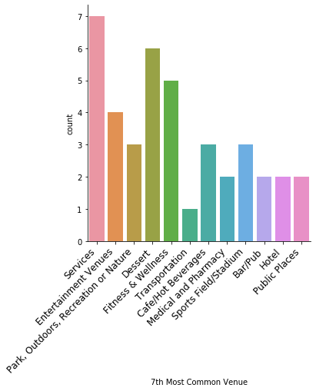
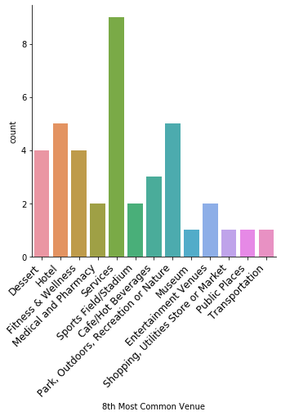
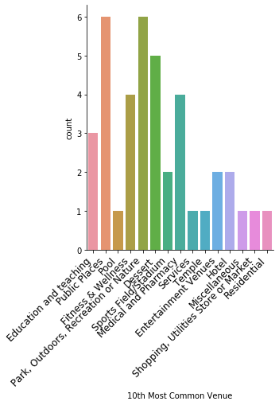
It is also reflected in the 10 plots below that show different venue categories in accordance to their count of appearance in most common venue categories column to 10th most common venue category column for every neighborhood.

Slide 8
How are the five clusters in New York distinct from each other?
Cluster 1 (NY)
Venue Categories | Count | Percentage in cluster | Overall Percentage | Percentage per neighborhood
Restaurant | 479 | 44.85018727 | 41.4 | 3.18
Bar/Pub | 129 | 12.07865169 | 41.08 | 3.16
Shopping, Utilities Store or Market | 106 | 9.925093633 | 25.98 | 2
Cafe/Hot Beverages | 84 | 7.865168539 | 32.68 | 2.51
Dessert | 64 | 5.992509363 | 41.56 | 3.2
Entertainment Venues | 47 | 4.400749064 | 24.74 | 1.903076923
Fitness & Wellness | 43 | 4.026217228 | 26.71 | 2.054615385
Services | 31 | 2.902621723 | 26.27 | 2.020769231
Park, Outdoors, Recreation or Nature | 25 | 2.34082397 | 17.36 | 1.335384615
Hotel | 23 | 2.153558052 | 34.85 | 2.680769231
Public Places | 12 | 1.123595506 | 24.49 | 1.883846154
Medical and Pharmacy | 8 | 0.74906367 | 33.33 | 2.563846154
Sports Field/Stadium | 5 | 0.468164794 | 19.23 | 1.479230769
Museum | 4 | 0.374531835 | 40 | 3.076923077
Education and teaching | 3 | 0.280898876 | 30 | 2.307692308
Residential | 2 | 0.187265918 | 18.18 | 1.398461538
Transportation | 2 | 0.187265918 | 16.67 | 1.282307692
Pool | 1 | 0.093632959 | 33.33 | 2.563846154
Total Neighborhoods in Cluster |  |  | 13
Total Venues in Cluster |  |  | 1068
Key Points:
40% of all museums in Manhattan are situated in cluster 1.
Around 35% of all hotels in Manhattan are situated in cluster 1.
33% of all pools are located in Cluster 1
25% of all Public places in Cluster 1
41.4% of all Restaurants as well as 41.08% of all Bars/Pubs are situated in this cluster

Slide 9
How are the five clusters in New York distinct from each other?
Cluster 2 (NY)
Venue Categories | Count | Percentage in cluster | Overall Percentage | Percentage per neighborhood
Park, Outdoors, Recreation or Nature | 25 | 22.93578 | 17.36 | 5.786666667
Restaurant | 21 | 19.26606 | 1.82 | 0.606666667
Shopping, Utilities Store or Market | 12 | 11.00917 | 2.94 | 0.98
Bar/Pub | 7 | 6.422018 | 2.23 | 0.743333333
Public Places | 7 | 6.422018 | 14.29 | 4.763333333
Cafe/Hot Beverages | 6 | 5.504587 | 2.33 | 0.776666667
Fitness & Wellness | 6 | 5.504587 | 3.73 | 1.243333333
Sports Field/Stadium | 6 | 5.504587 | 23.08 | 7.693333333
Hotel | 4 | 3.669725 | 6.06 | 2.02
Transportation | 4 | 3.669725 | 33.33 | 11.11
Services | 3 | 2.752294 | 2.54 | 0.846666667
Dessert | 2 | 1.834862 | 1.3 | 0.433333333
Education and teaching | 2 | 1.834862 | 20 | 6.666666667
Entertainment Venues | 2 | 1.834862 | 1.05 | 0.35
Residential | 2 | 1.834862 | 18.18 | 6.06
Total Neighborhoods in Cluster |  |  | 3
Total Venues in Cluster |  |  | 109
Key Points:
23% of all Sports Fields/Stadiums with a high impact per neighborhood index.
33.33% of all Transportation facilities with an exceptionally high impact per neighborhood.
17.36% of all Park, Outdoors, Recreation or Nature venues which also constitute 23% of all venues in Cluster 2.
20% of all venues belonging to Educational and Teaching category in Manhattan lies in Cluster 2. The impact per neighborhood index is also notably high.
High number of Residential venues and fairly low number of Entertainment venues.
A fairly good numbers (although least in comparison to other clusters) of Restaurant, Shops, Utilities Stores, and Market in the neighborhoods in this Cluster.

Slide 10
How are the five clusters in New York distinct from each other?
Cluster 3 (NY)
Venue Categories | Count | Percentage in cluster | Overall Percentage | Percentage per neighborhood
Restaurant | 300 | 33.97508 | 25.9291271 | 2.59291271
Shopping, Utilities Store or Market | 173 | 19.5923 | 42.4019608 | 4.24019608
Cafe/Hot Beverages | 77 | 8.720272 | 29.9610895 | 2.99610895
Bar/Pub | 72 | 8.15402 | 22.9299363 | 2.29299363
Fitness & Wellness | 60 | 6.795017 | 37.2670807 | 3.72670807
Dessert | 52 | 5.889015 | 33.7662338 | 3.37662338
Services | 43 | 4.869762 | 36.440678 | 3.6440678
Entertainment Venues | 38 | 4.303511 | 20 | 2
Park, Outdoors, Recreation or Nature | 20 | 2.265006 | 13.8888889 | 1.38888889
Hotel | 17 | 1.925255 | 25.7575758 | 2.57575758
Public Places | 8 | 0.906002 | 16.3265306 | 1.63265306
Medical and Pharmacy | 6 | 0.679502 | 25 | 2.5
Museum | 5 | 0.566251 | 50 | 5
Sports Field/Stadium | 5 | 0.566251 | 19.2307692 | 1.92307692
Education and teaching | 2 | 0.226501 | 20 | 2
Miscellaneous | 2 | 0.226501 | 66.6666667 | 6.66666667
Office | 1 | 0.11325 | 33.3333333 | 3.33333333
Pool | 1 | 0.11325 | 33.3333333 | 3.33333333
Transportation | 1 | 0.11325 | 8.33333333 | 0.833333333
Total Neighborhoods in Cluster |  |  | 10
Total Venues in Cluster |  |  | 883
Key Points:
50% of all Museums and 26% of all hotels lie in Cluster 3.
36% of all stores that offer some kind of Services in Manhattan are in Cluster 3.
19% of all Sports fields/Stadiums, 16% of all Public Places, 14% of all Parks, Outdoors, Recreation and Nature venues as well as 20% of all Entertainment venues.
Over 42% of all Shops, Utilities Stores or Markets are in Cluster 3. There are also fairly good amount of Restaurants, Cafes, Bars and Transportation facilities.
Over 37% of all venues belonging to Fitness and Wellness category are situated here.
No residential venue.

Slide 11
How are the five clusters in New York distinct from each other?
Cluster 4 (NY)
Venue Categories | Count | Percentage in cluster | Overall Percentage | Percentage per neighborhood
Restaurant | 134 | 44.22442 | 11.58168 | 2.316336
Park, Outdoors, Recreation or Nature | 31 | 10.23102 | 21.52778 | 4.305556
Cafe/Hot Beverages | 30 | 9.90099 | 11.67315 | 2.33463
Shopping, Utilities Store or Market | 28 | 9.240924 | 6.862745 | 1.372549
Bar/Pub | 20 | 6.60066 | 6.369427 | 1.2738854
Services | 14 | 4.620462 | 11.86441 | 2.372882
Fitness & Wellness | 13 | 4.290429 | 8.074534 | 1.6149068
Public Places | 6 | 1.980198 | 12.2449 | 2.44898
Entertainment Venues | 5 | 1.650165 | 2.631579 | 0.5263158
Dessert | 4 | 1.320132 | 2.597403 | 0.5194806
Medical and Pharmacy | 4 | 1.320132 | 16.66667 | 3.333334
Hotel | 3 | 0.990099 | 4.545455 | 0.909091
Sports Field/Stadium | 3 | 0.990099 | 11.53846 | 2.307692
Transportation | 3 | 0.990099 | 25 | 5
Residential | 2 | 0.660066 | 18.18182 | 3.636364
Miscellaneous | 1 | 0.330033 | 33.33333 | 6.666666
Museum | 1 | 0.330033 | 10 | 2
Office | 1 | 0.330033 | 33.33333 | 6.666666
Total Neighborhoods in Cluster |  |  | 5
Total Venues in Cluster |  |  | 303
Key Points:
Although only 10% of all venues in the cluster belong to Parks, Outdoors, Recreation or Nature category, they contribute 21% among all such venues in Manhattan.
18% of all residential apartments/houses in Manhattan lie in cluster 4.
17% of all Medicals and Pharmacies lie in Cluster 3.
Very good availability of Transportation facilities.
44% of all venues in cluster 3 are Restaurants. A fairly high number of such restaurants are specialty restaurants serving Asian, Indian, Middle Eastern and Mexican cuisine.
A fairly low number of Entertainment venues and Hotels.

Slide 12
How are the five clusters in New York distinct from each other?
Cluster 5 (NY)
Venue Categories | Count | Percentage in cluster | Overall Percentage | Percentage per neighborhood
Restaurant | 223 | 29.41952507 | 19.27398 | 2.141553333
Entertainment Venues | 98 | 12.92875989 | 51.57895 | 5.730994444
Shopping, Utilities Store or Market | 89 | 11.7414248 | 21.81373 | 2.423747778
Bar/Pub | 86 | 11.34564644 | 27.38854 | 3.043171111
Cafe/Hot Beverages | 60 | 7.915567282 | 23.3463 | 2.594033333
Park, Outdoors, Recreation or Nature | 43 | 5.672823219 | 29.86111 | 3.317901111
Fitness & Wellness | 39 | 5.145118734 | 24.2236 | 2.691511111
Dessert | 32 | 4.221635884 | 20.77922 | 2.308802222
Services | 27 | 3.562005277 | 22.88136 | 2.542373333
Hotel | 19 | 2.506596306 | 28.78788 | 3.198653333
Public Places | 16 | 2.110817942 | 32.65306 | 3.628117778
Sports Field/Stadium | 7 | 0.92348285 | 26.92308 | 2.991453333
Medical and Pharmacy | 6 | 0.791556728 | 25 | 2.777777778
Residential | 5 | 0.659630607 | 45.45455 | 5.050505556
Education and teaching | 3 | 0.395778364 | 30 | 3.333333333
Transportation | 2 | 0.263852243 | 16.66667 | 1.851852222
Office | 1 | 0.131926121 | 33.33333 | 3.703703333
Pool | 1 | 0.131926121 | 33.33333 | 3.703703333
Temple | 1 | 0.131926121 | 100 | 11.11111111
Total Neighborhoods in Cluster |  |  | 9
Total Venues in Cluster |  |  | 758
Key Points:
52% of all Entertainment Venue.
A fairly good number of Shops & Markets, Bars, Pub, Cafes, Parks, Outdoors, Recreational venues, and Natural places.
24% of all Fitness & Wellness related venues are in cluster 5. Moreover, most of these venues are Gyms, Sports clubs, or Fitness centers that attract young crowd.
Over 45% of all Residential venues lie in this cluster. It is also backed by good availability transportation facilities.
30% of all Educational and teaching venues lie in this cluster.
High number of Sports venues, Public places, hotels, and stores offering services of different kinds.
29% of all venues in this cluster are restaurants, many of which are economical fast food shops serving all different kinds of food.

Slide 13
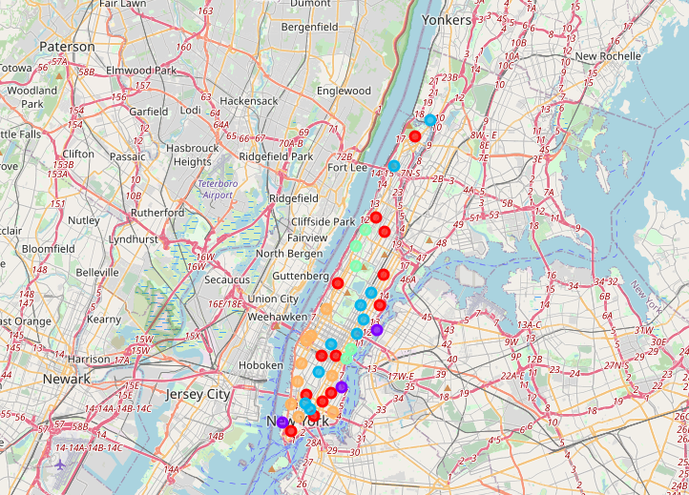
The five clusters, which are comprised of different neighborhoods, can be identified as follows:
Cluster 1: Decent residential areas having a mix of general characteristics desired in a neighborhood.
Cluster 2: Suitable for people who love calm and simple life. Suggested for families with young children, elderly people and people wanting to get away from busy city life.
Cluster 3: Major tourist and shopping place. Suggested for tourists, shopaholics and outdoor people.
Cluster 4: Decent residential areas. Suitable for immigrants who tend to live in societies with other immigrants as well as people belonging to poor sections of the society.
Cluster 5: Suitable for youngsters, bachelors, students and people interested in chaotic yet quality city life.

Slide 14
Machine Learning Algorithms
K means Clustering:
K means clustering algorithm was used to segment the neighborhoods in five clusters based on the top ten most common venue categories in each neighborhood. The following table gives the number of neighborhoods assigned to each cluster label (marked 0 to 4).
K nearest neighbors:
In order to classify a data point to a certain class, this algorithm takes into consideration its k nearest neighbor data points. The number of nearest neighbors to consider (k) is a critical part of this algorithm. The optimal k value is simply determined by running the algorithm for a series of different values of k, and choosing the one with the highest accuracy. The optimal value of nearest neighbors was found to be 4.
Knn algorithm was trained on 80% of the dataset, while the rest was used for testing. An accuracy of 50% was achieved on the test set.
Cluster Label | Number of Neighborhoods
0 | 13
1 | 3
2 | 10
3 | 5
4 | 9

Slide 15
Mumbai City
Cluster 1 (Mumbai)
Venue Category | Count | Percentage in cluster | Overall Percentage | Percentage per neighborhood
Restaurant | 168 | 43.75 | 28.66894198 | 1.303133726
Dessert | 51 | 13.28125 | 36.17021277 | 1.64410058
Cafe/Hot Beverages | 39 | 10.15625 | 28.88888889 | 1.313131313
Shopping, Utilities Store or Market | 32 | 8.333333333 | 22.37762238 | 1.017164654
Bar/Pub | 29 | 7.552083333 | 27.10280374 | 1.231945624
Entertainment Venues | 21 | 5.46875 | 28.37837838 | 1.28992629
Fitness & Wellness | 8 | 2.083333333 | 27.5862069 | 1.253918495
Hotel | 8 | 2.083333333 | 25.80645161 | 1.173020528
Park, Outdoors, Recreation or Nature | 8 | 2.083333333 | 20.51282051 | 0.932400932
Public Places | 5 | 1.302083333 | 31.25 | 1.420454545
Transportation | 4 | 1.041666667 | 14.81481481 | 0.673400673
Services | 3 | 0.78125 | 17.64705882 | 0.802139037
Sports Field/Stadium | 3 | 0.78125 | 37.5 | 1.704545455
Pool | 2 | 0.520833333 | 100 | 4.545454545
Miscellaneous | 1 | 0.260416667 | 33.33333333 | 1.515151515
Museum | 1 | 0.260416667 | 33.33333333 | 1.515151515
Residential | 1 | 0.260416667 | 33.33333333 | 1.515151515
Total neighborhoods in cluster |  |  | 22
Total venues in cluster |  |  | 384
Cluster 2 (Mumbai)
Venue Category | Count | Percentage in cluster | Overall Percentage |  | Percentage per neighborhood
Bar/Pub | 9 | 29.03225806 | 8.411214953 |  | 4.205607477
Restaurant | 9 | 29.03225806 | 1.535836177 |  | 0.767918089
Entertainment Venues | 5 | 16.12903226 | 6.756756757 |  | 3.378378378
Dessert | 3 | 9.677419355 | 2.127659574 |  | 1.063829787
Hotel | 2 | 6.451612903 | 6.451612903 |  | 3.225806452
Shopping, Utilities Store or Market | 2 | 6.451612903 | 1.398601399 |  | 0.699300699
Cafe/Hot Beverages | 1 | 3.225806452 | 0.740740741 |  | 0.37037037
Total neighborhoods in cluster |  |  |  | 2
Total venues in cluster |  |  |  | 31

Slide 16
Cluster 3 (Mumbai)
Venue Category | Count | Percentage in cluster | Overall Percentage |  | Percentage per neighborhood
Restaurant | 253 | 44 | 43.17406143 |  | 1.166866525
Shopping, Utilities Store or Market | 64 | 11.13043478 | 44.75524476 |  | 1.20960121
Cafe/Hot Beverages | 54 | 9.391304348 | 40 |  | 1.081081081
Dessert | 52 | 9.043478261 | 36.87943262 |  | 0.996741422
Bar/Pub | 37 | 6.434782609 | 34.57943925 |  | 0.934579439
Entertainment Venues | 29 | 5.043478261 | 39.18918919 |  | 1.059167275
Park, Outdoors, Recreation or Nature | 21 | 3.652173913 | 53.84615385 |  | 1.455301455
Transportation | 18 | 3.130434783 | 66.66666667 |  | 1.801801802
Hotel | 13 | 2.260869565 | 41.93548387 |  | 1.133391456
Services | 12 | 2.086956522 | 70.58823529 |  | 1.907790143
Fitness & Wellness | 10 | 1.739130435 | 34.48275862 |  | 0.931966449
Public Places | 5 | 0.869565217 | 31.25 |  | 0.844594595
Sports Field/Stadium | 3 | 0.52173913 | 37.5 |  | 1.013513514
Miscellaneous | 2 | 0.347826087 | 66.66666667 |  | 1.801801802
Museum | 2 | 0.347826087 | 66.66666667 |  | 1.801801802
Total neighborhoods in cluster |  |  |  | 37
Total venues in cluster |  |  |  | 575
Cluster 4 (Mumbai)
Venue Category | Count | Percentage in cluster | Overall Percentage | Percentage per neighborhood
Restaurant | 90 | 40.7239819 | 15.35836177 | 1.279863481
Cafe/Hot Beverages | 23 | 10.40723982 | 17.03703704 | 1.419753086
Dessert | 23 | 10.40723982 | 16.31205674 | 1.359338061
Shopping, Utilities Store or Market | 20 | 9.049773756 | 13.98601399 | 1.165501166
Bar/Pub | 19 | 8.597285068 | 17.75700935 | 1.479750779
Entertainment Venues | 11 | 4.977375566 | 14.86486486 | 1.238738739
Fitness & Wellness | 8 | 3.619909502 | 27.5862069 | 2.298850575
Park, Outdoors, Recreation or Nature | 7 | 3.167420814 | 17.94871795 | 1.495726496
Hotel | 6 | 2.714932127 | 19.35483871 | 1.612903226
Public Places | 4 | 1.809954751 | 25 | 2.083333333
Transportation | 3 | 1.357466063 | 11.11111111 | 0.925925926
Medical and Pharmacy | 2 | 0.904977376 | 100 | 8.333333333
Residential | 2 | 0.904977376 | 66.66666667 | 5.555555556
Services | 2 | 0.904977376 | 11.76470588 | 0.980392157
Sports Field/Stadium | 1 | 0.452488688 | 12.5 | 1.041666667
Total neighborhoods in cluster |  |  | 12
Total venues in cluster |  |  | 221

Slide 17
Venue Category | Count | Percentage in cluster | Overall Percentage | Percentage per neighborhood
Restaurant | 66 | 42.30769231 | 11.26279863 | 0.938566553
Shopping, Utilities Store or Market | 25 | 16.02564103 | 17.48251748 | 1.456876457
Cafe/Hot Beverages | 18 | 11.53846154 | 13.33333333 | 1.111111111
Bar/Pub | 13 | 8.333333333 | 12.14953271 | 1.012461059
Dessert | 12 | 7.692307692 | 8.510638298 | 0.709219858
Entertainment Venues | 8 | 5.128205128 | 10.81081081 | 0.900900901
Fitness & Wellness | 3 | 1.923076923 | 10.34482759 | 0.862068966
Park, Outdoors, Recreation or Nature | 3 | 1.923076923 | 7.692307692 | 0.641025641
Hotel | 2 | 1.282051282 | 6.451612903 | 0.537634409
Public Places | 2 | 1.282051282 | 12.5 | 1.041666667
Transportation | 2 | 1.282051282 | 7.407407407 | 0.617283951
Education and teaching | 1 | 0.641025641 | 100 | 8.333333333
Sports Field/Stadium | 1 | 0.641025641 | 12.5 | 1.041666667
Total neighborhoods in cluster |  |  | 12
Total venues in cluster |  |  | 156
The following observations are made about the clusters in Mumbai City:
Cluster 1:
Ideally, the neighborhoods must be decent residential areas having a mix of all general characteristics. In the present case, the neighborhoods have ample amount of restaurants, cafes, markets, public places, parks and other types of venues. Thus they offer a wide array of options and therefore, can be termed as ‘general’ neighborhoods. As expected, 22 out of 85 neighborhoods of Mumbai are situated in this cluster, making it the second most populated cluster of the city.
Cluster 2:
Ideally, the neighborhoods should be calm and peaceful, attracting people who wants to get away from busy city life. Cluster 2 matches the profile most suitably in comparison to any other cluster of Mumbai City. Although its characteristics are still very different from the cluster 2 in New York. While the neighborhoods of New York had more open spaces (such as parks, natural venues, sports fields) and less restaurants and bars, the case with Mumbai is completely opposite. Still, the lesser number of Hotels and Cafes, and absence of many other types of venues in the neighborhoods suggest a similar profile. Unsurprisingly in a city like a Mumbai, there are only 2 neighborhoods matching such profile.

Slide 18
Cluster 3:
Ideally, the neighborhoods should be more chaotic and busy with tourists and customers flocking to restaurants, bars, public places, museums, and markets etc. Considering Mumbai, it’s safe to argue that a majority of its neighborhoods may end up in this cluster. Unsurprisingly, 37 of its neighborhoods belong to this cluster. The cluster also has good transportation facilities, serving to the crowd of people travelling to and from these neighborhoods. The cluster also has 54% of the city’s parks, outdoors and recreational venues unlike the case of New York where the number was below 14%, indicating the city’s poor planning. Also there wasn’t any residential venue listed in this cluster in New York, as has been the case with Mumbai. Although, this could be again due to inadequate amount of data as most busy areas of India’s cities are also crowded residential areas.
Cluster 4:
Ideally, the neighborhoods should be more suitable for either immigrants and poor section of the society, or well off people living in closed societies. The suitability of this cluster for two extremely different type of people may be disappointing, although the current model cannot make such distinction as such factors are not included in the process. For example, the current model treats all restaurants as similar, without making any distinction in roadside dhabas, economical fast food joints, or expensive diner. The neighborhoods have less entertainment venues and stores offering services and have major residential areas.
Cluster 5:
Ideally, the neighborhoods should be suitable for students, bachelors and young people interested in experiencing the busy yet quality city life. Although due to the inadequate data, especially in regards of Residential venues, a clear picture cannot be obtained about these neighborhoods. Comparing all clusters of Mumbai to the respective clusters of New York, this cluster inarguably differs the most from cluster 5 of New York.

Slide 19
Conclusion
The project aims at looking at Mumbai through the New York lens, and observing the key similarities as well as differences, and identifying the key areas of improvement. Despite inadequate amount of data and limitations of using Foursquare in such a study, the report has successfully laid down critical observations and discussed some very important issues. Identifying different areas of Mumbai having similarities to New York will be helpful in planning infrastructure development and resource management of those areas to achieve their understated potential. It can also indicate towards the potential of certain neighborhoods that might not have been looked at previously. This study suggests a completely different way of planning a city’s development.
The key difference between Mumbai and New York is in the vision and foresight of its authorities. While a large portion of New York was planned well in advance under The Commissioner’s plan of 1811, Mumbai didn’t witness any such attempts. And that has hampered its ability to achieve its true potential.

